Slide 1

Nittany Market
Nicholas price
Section 1

Slide 2

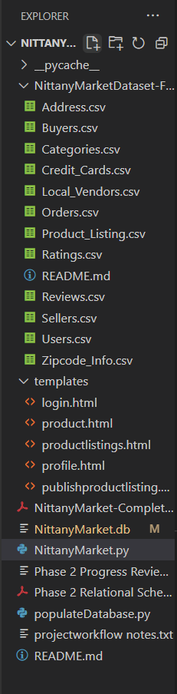
Resources used
SQLite3
Flask
HTML
CSS
JInja2
Git

Slide 3
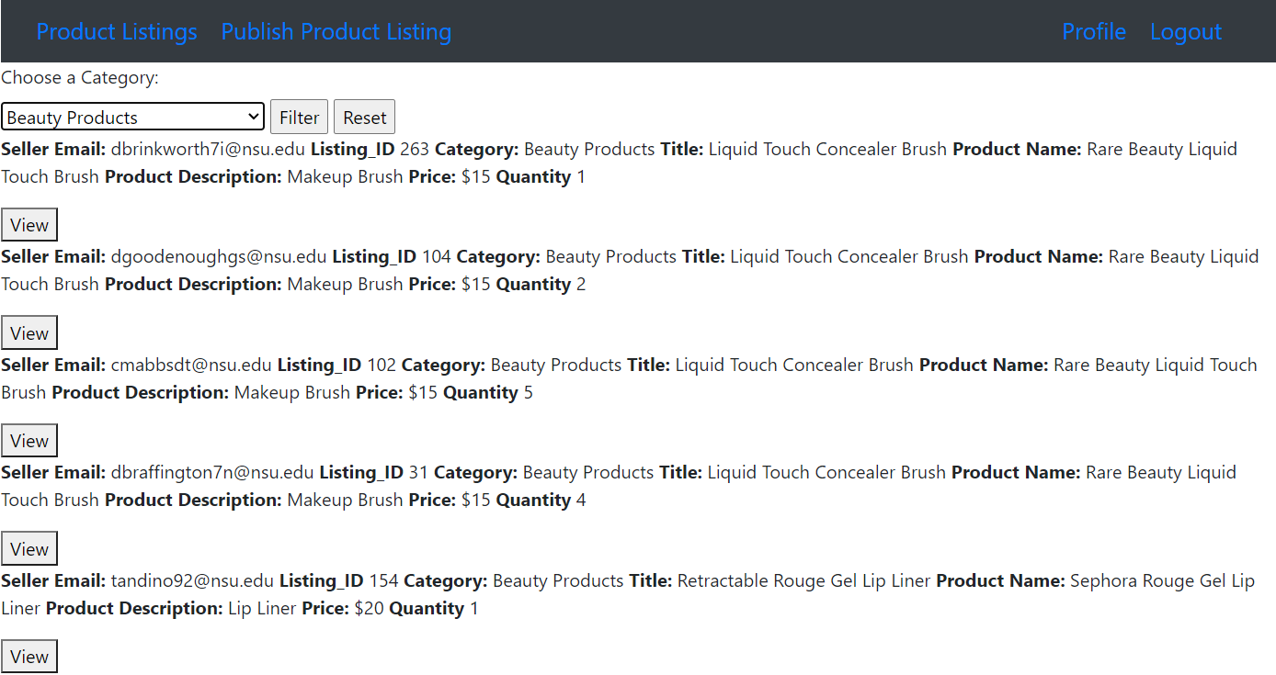
Features included
Product Listings
Category Hierarchy
User Authentication
Profile Page
Password Update
Publish Product Listing

Slide 4
reflections
Strengths
Elegant Code
Tested Webpages
Weaknesses
UI
Business Requirements
Minimal Features

Slide 5
Future additions
Updated Interface
Create Account
Placing Orders
Ratings
Email Confirmation
Unit Testing
Full Testing Pyramid

Slide 6
Final thoughts
Fun Project
Applicable knowledge

